Slide 1



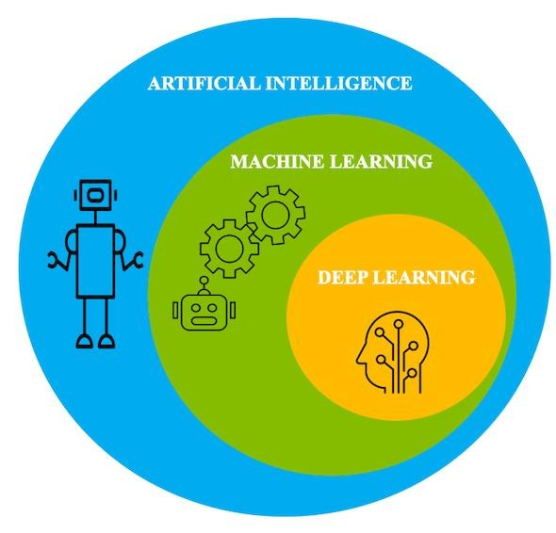


Lambton College
School of Computer Studies
AML-3104 Neural Networks
and Deep Learning

Slide 2
How to get in touch?
Send email to
–
Expect response within 24
hours
Please
–
–
Include [AML-3104_#] at the beginning into the subject line
Send email from your college account (college policy)

Slide 3
Who are you?

Slide 4
Required Materials
•
Neural Networks and Deep
Author: Charu C. Aggarwal
ISBN-13: 978-3319944623
Publisher: Springer
Published: 26 August 2018
Learning:
A
Textbook
•
Deep Learning
Author: Ian Goodfellow, Yoshua
ISBN-13: 978-0262035613
Publisher: The MIT Press
Published: 18 November 2016
Bengio and Aaron Courville

Slide 5
Learning Outcomes
•
•
•
•
•
•
•
•
Explore Neural networks.
Evaluate the Applications of Neural
Networks.
Demonstrate Machine Learning Basics.
Explore Machine Learning Algorithms.
Basic Architecture of Neural Networks.
Training of a Neural Network
Evaluate Deep Neural Network
Recommend Deep Neural Network Implementation

Slide 6
Review Policies
• Late Assignments/exams

Slide 7
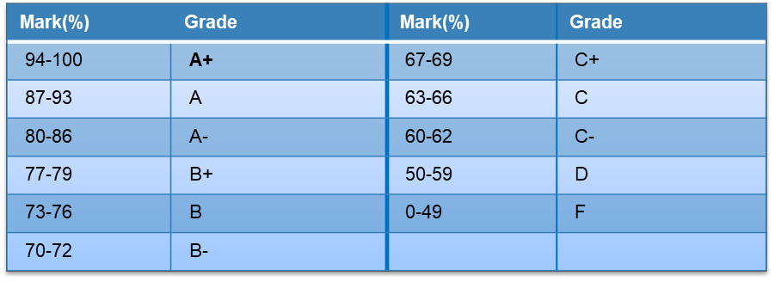
Evaluation
•
Evaluation
methods
Tests (40%):
• Midterm Test (20%)
• Final Exam (20%) Assignments and Projects (60%):
• Assignment (20%)
• Final Term Project (40%)
•
Marking scheme

Slide 8
Any questions so far?
Any comments?

Slide 9

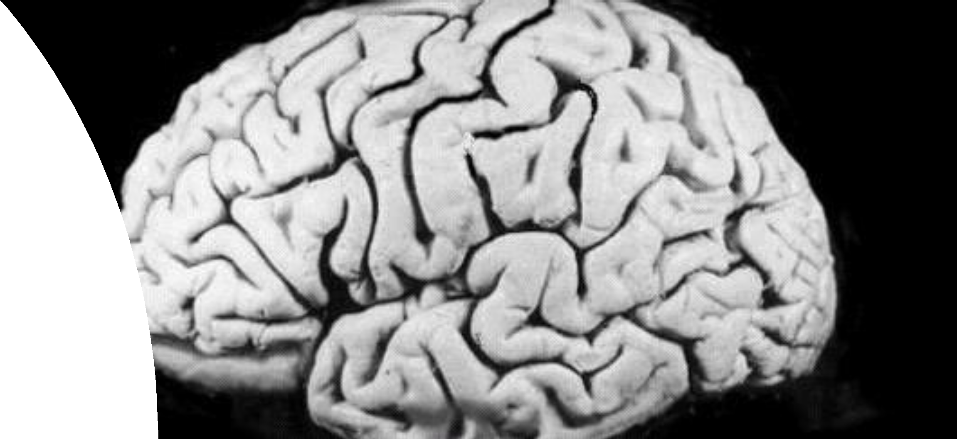
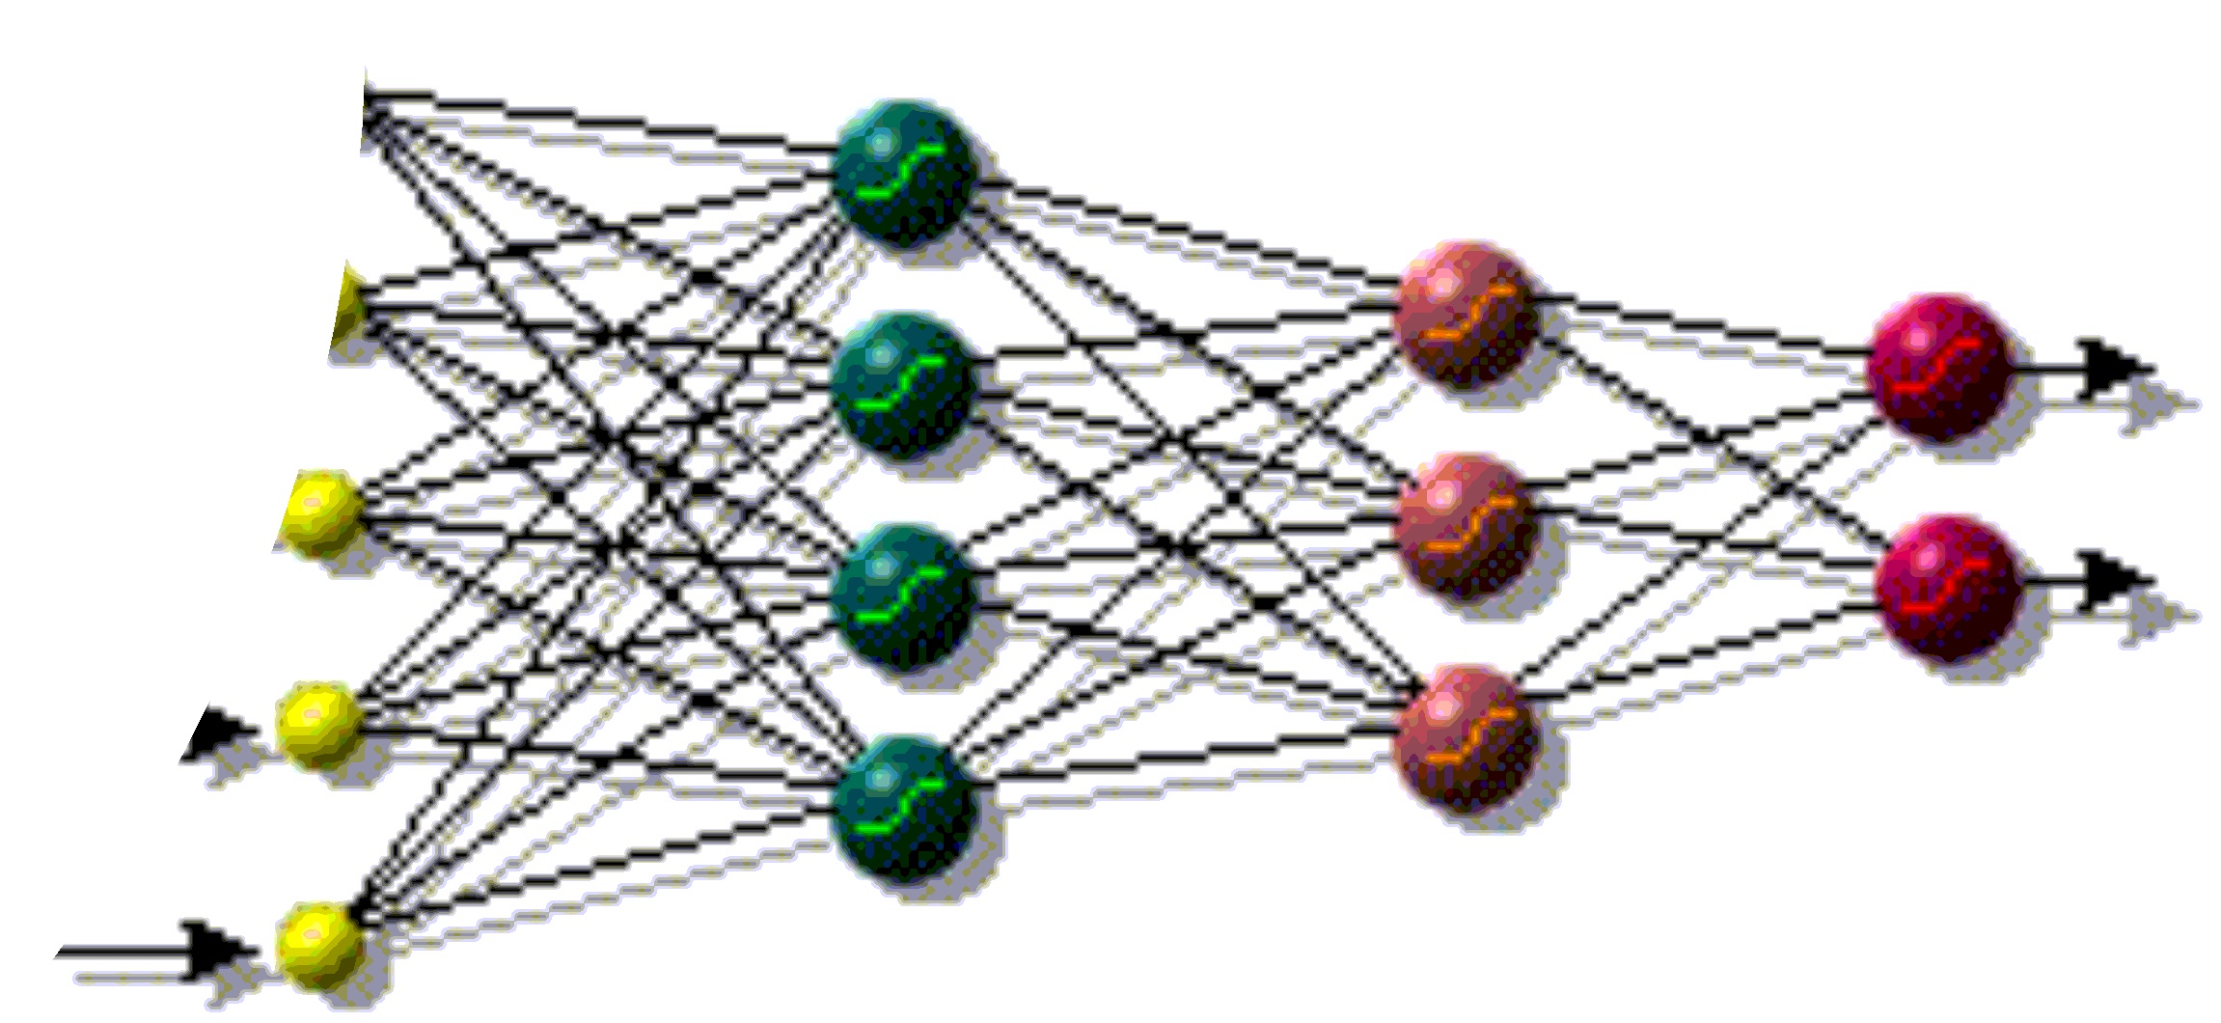
Neural Networks

Slide 10
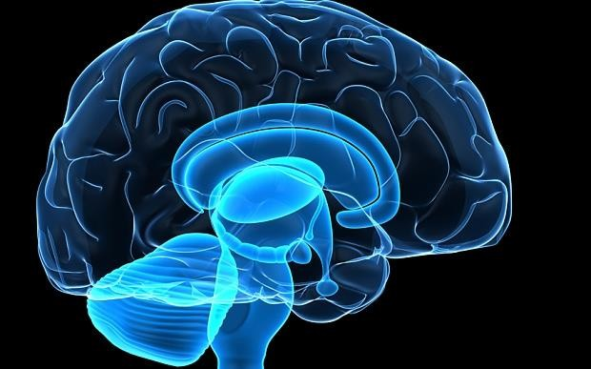
Human Brain
•
Consist of special
- Neurons
cells

Slide 11

Features of the Brain
•
•
•
•
•
Ten billion (10¹⁰) neurons
On average, several thousand
connections
Hundreds of operations per second
Die off frequently (never replaced)
Compensates for problems by massive
parallelism

Slide 12
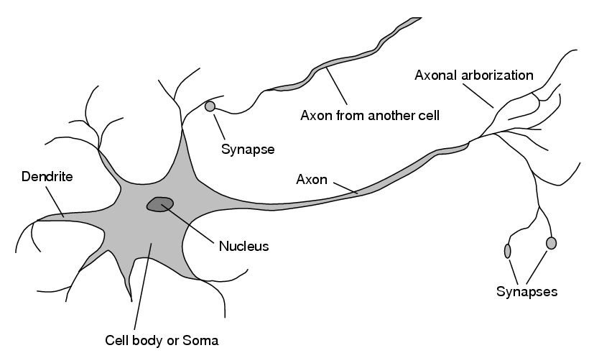
Structure of Neuron

Slide 13
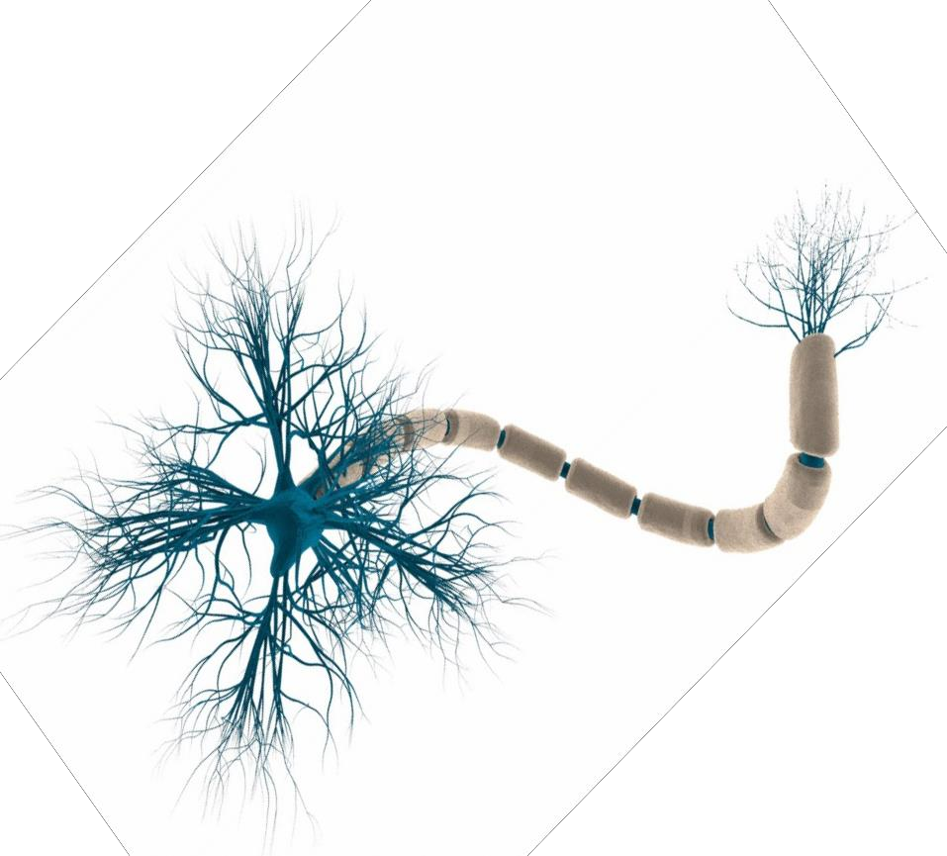
Neuron

Slide 14
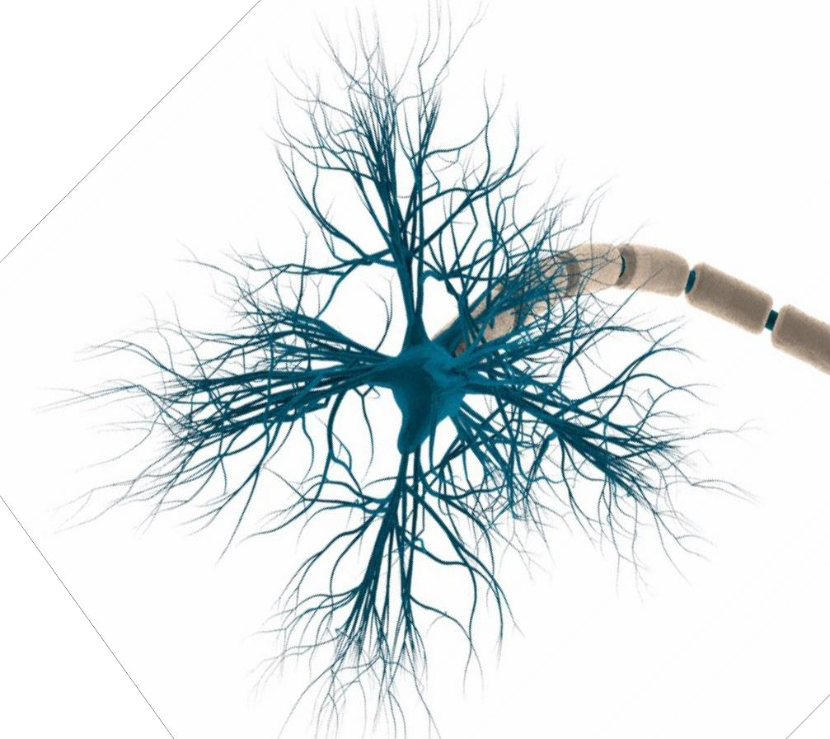
Neuron
Details
Dendrites
Cell Body

Slide 15
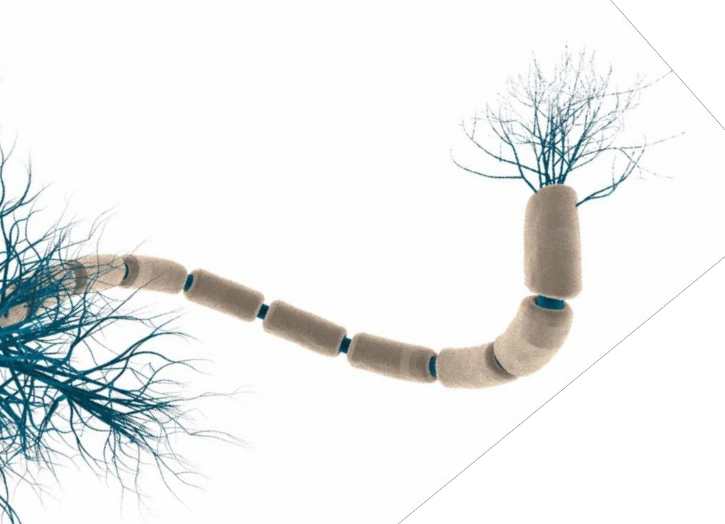
Neuron
Details
Presynaptic terminal
Axon

Slide 16
Structure of Neuron
A neuron has a cell body, a branching input
structure (the dendrIte) and a branching
output structure (the axOn)
• Axons connect to dendrites via synapses.
• Electro-chemical signals are propagated from the dendritic input, through the cell body, and down the axon to other neurons

Slide 17
Structure of Neuron
•
A neuron only fires if its input signal
exceeds a certain amount (the threshold)
in a short time period.
Synapses vary in strength
– Good connections allowing a large signal
– Slight connections allow only a weak signal.
•

Slide 18
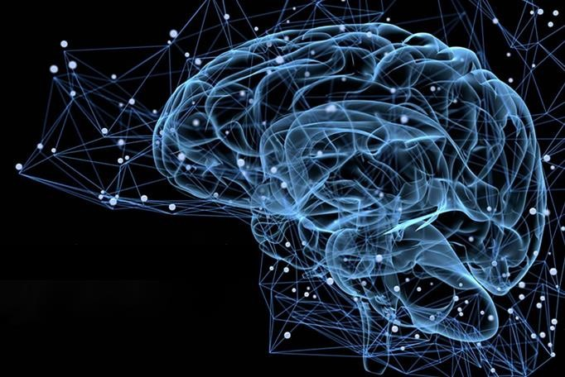
Artificial
Neural
Networks
Image: https://miro.medium.com/max/1400/1*jJs3ZVz8xMEjvThtFY4gDA.jpeg

Slide 19
Artificial Neural Networks
❑History
•
1943-McCulloch & Pitts are generally
of the first neural network
recognised as the designers
•
1949-First learning rule
•
1969-Minsky & Papert - perceptron
limitation - Death of ANN
•
1980’s - Re-emergence of ANN - multi-layer networks

Slide 20
The Biological Inspiration
•
The brain has been extensively studied
scientists.
by
•
Vast complexity prevents all but rudimentary
understanding.
Even the behaviour of an individual neuron is extremely complex
•

Slide 21
The Biological
Inspiration
•
Single “percepts”
neurons
distributed among
many
•
Localized parts of the brain are responsible
for certain well-defined functions (e.g. vision, motion).

Slide 22
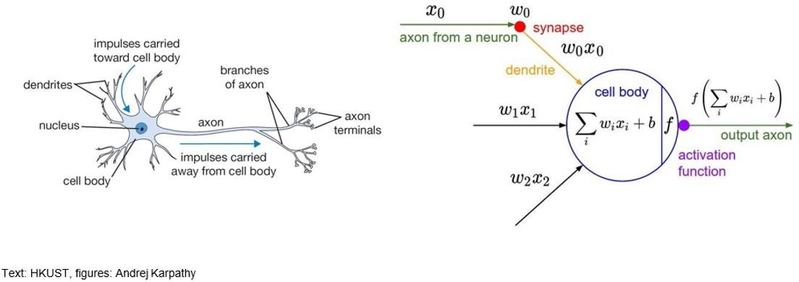
Inspiration: Neuron Cells

Slide 23
Inspiration: Neuron Cells
•
Neurons
- Accept information from multiple inputs.
- Transmit information to other neurons.
•
Multiply inputs by weights along edges
•
Apply some function to set the set of inputs
at each node
•
If output of function over threshold, neuron
“fires”

Slide 24
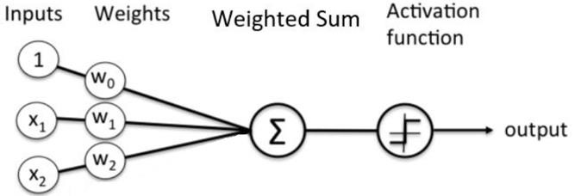
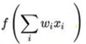
Inspiration: Neuron Cells

Slide 25


Human versus
Computers

Slide 26
Human Brain
•
The Brain
– Pattern Recognition
– Association
– Complexity
– Noise Tolerance

Slide 27
Computing
Machines
•
The Machine
– Calculation
– Precision
– Logic

Slide 28
The
Contrast
in
Architecture
•
A single processing unit;
–
Tens of millions of operations
second
per
–
Absolute
arithmetic
precision
•
The brain uses many slow
unreliable processors acting in parallel

Slide 29
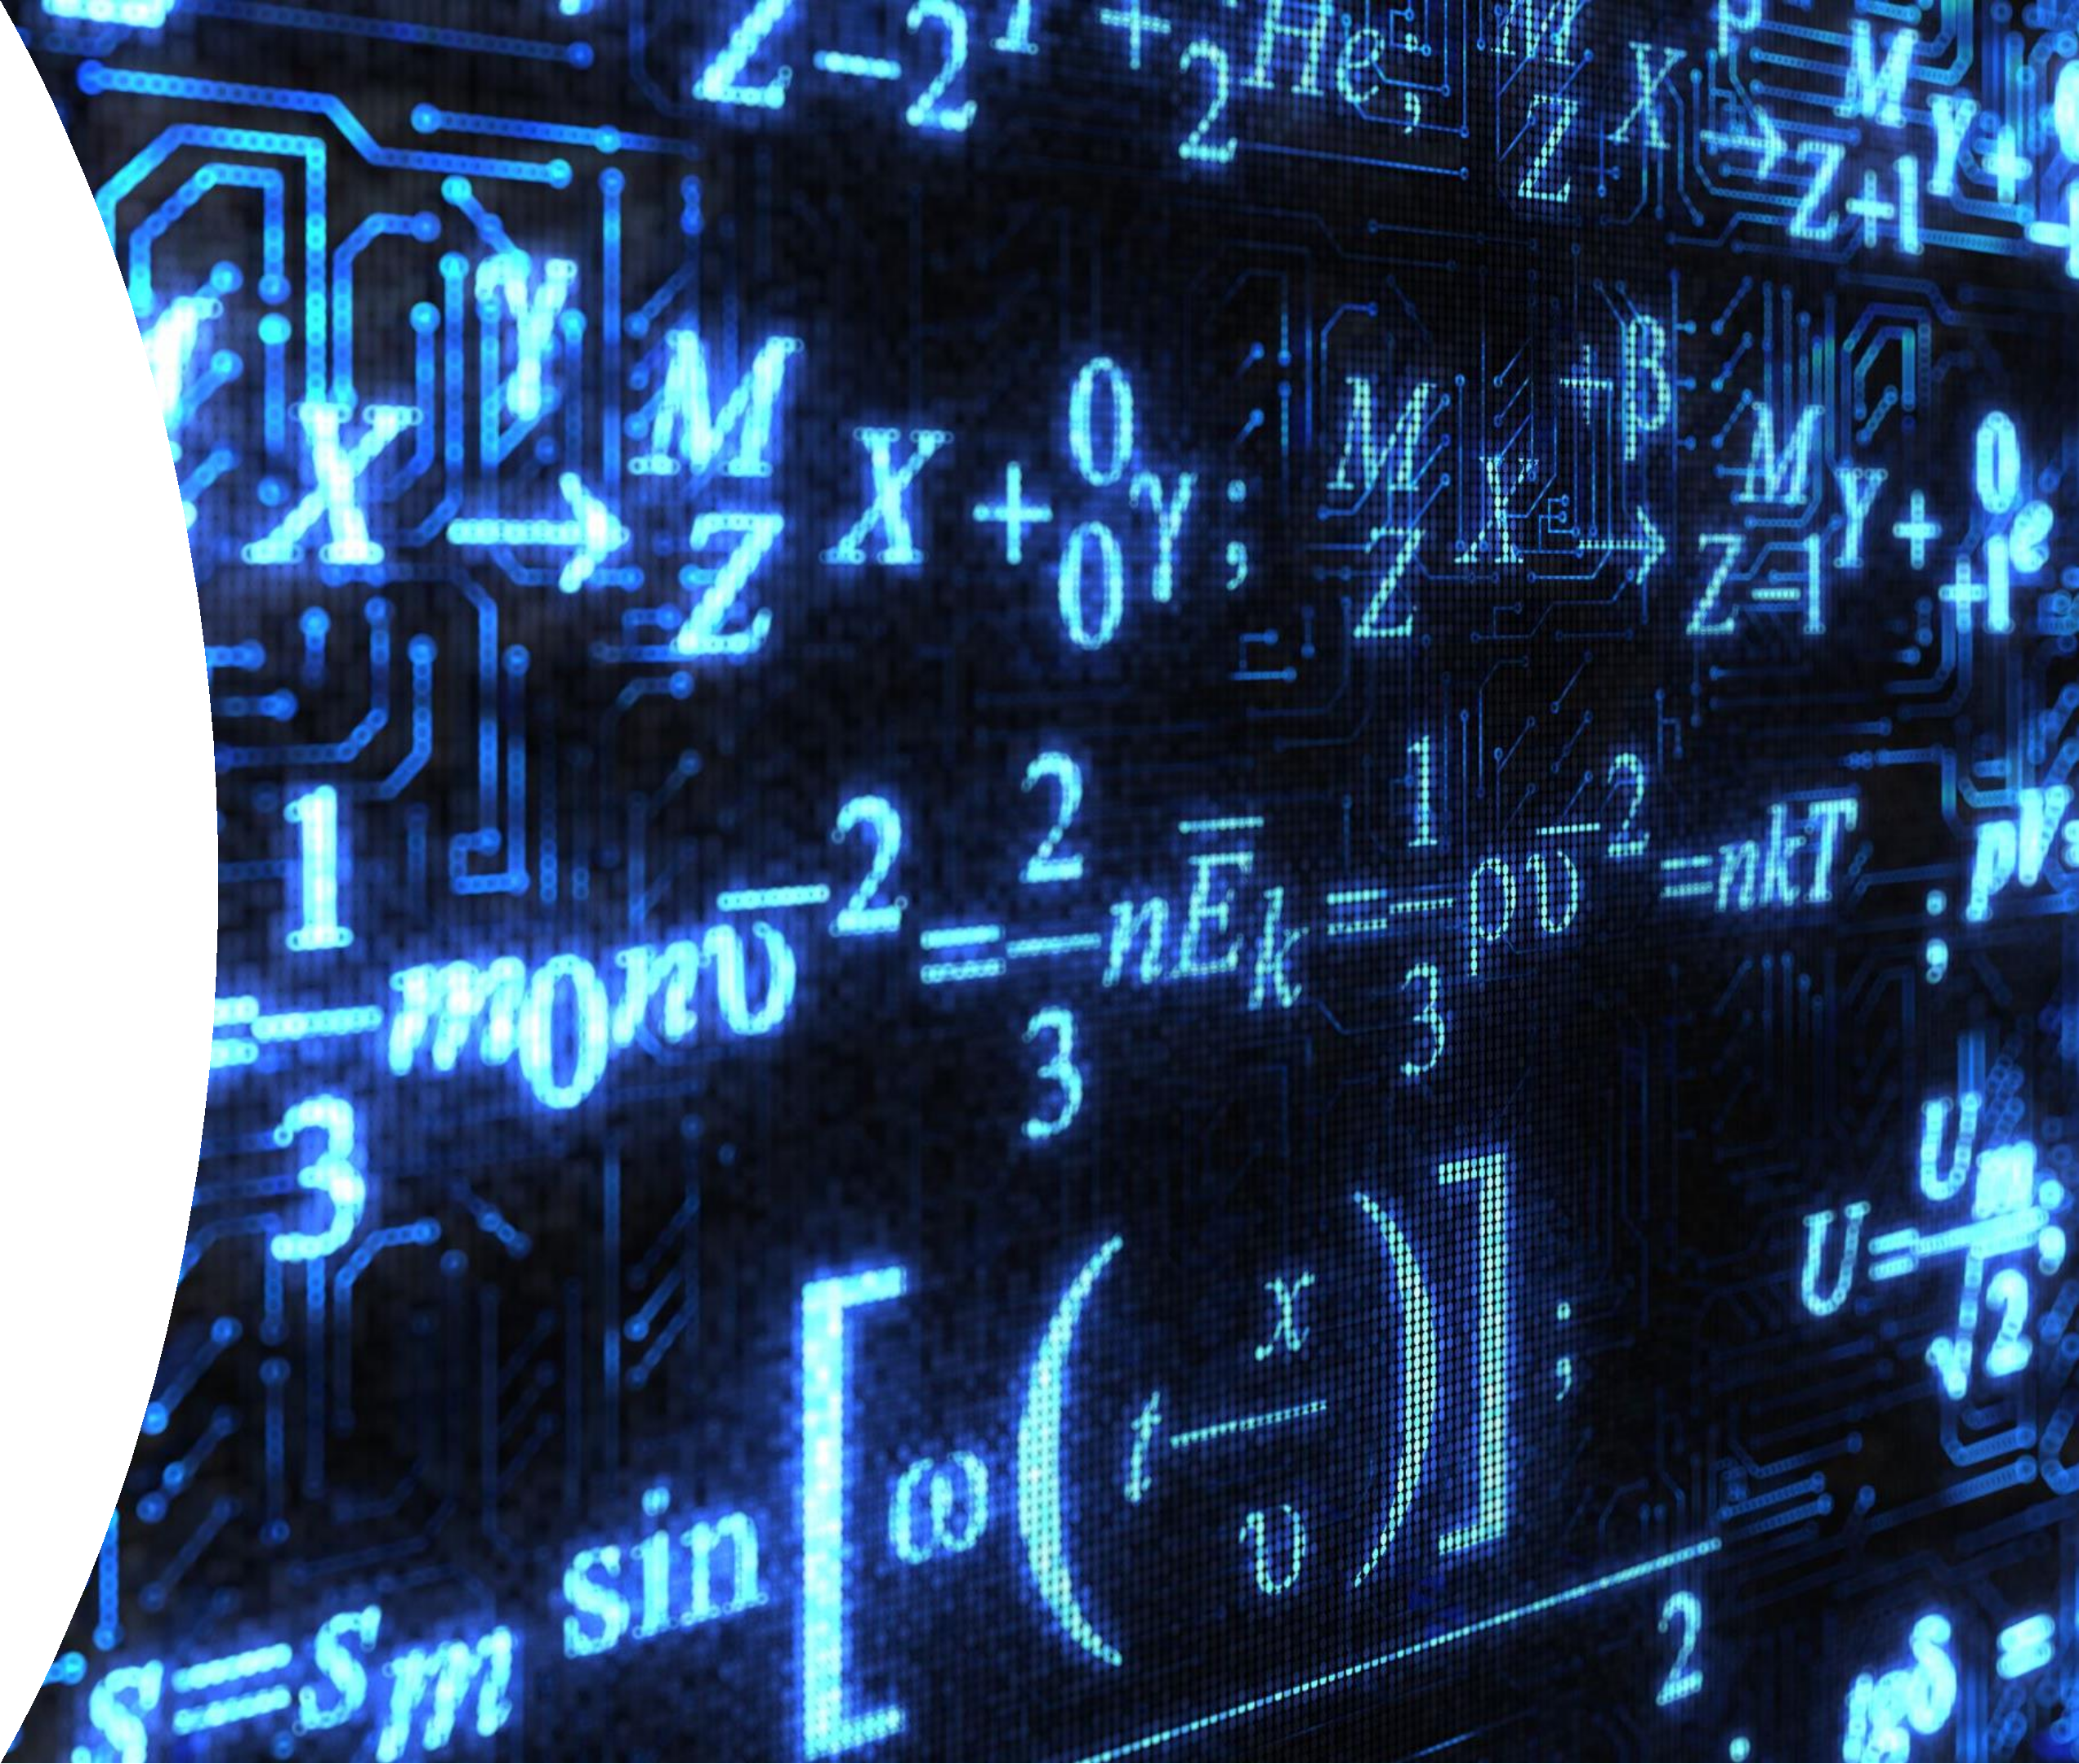
Linear Algebra

Slide 30
Linear Algebra
•
Linear algebra is the
equations such as
branch of mathematics concerning linear
and their representations through matrices and vector spaces.
•
It allows modeling many natural phenomena, and efficiently
computing with such models.

Slide 31
Linear Algebra
•
Topics
Vector
Matrix
Matrix operations
Identity matrix
Diagonal matrix
Transpose of a matrix
Symmetric matrix
Norm
•
•
•
•
•
•
•

Slide 32
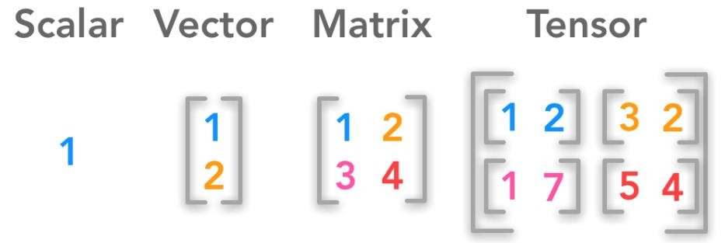
Scalar, Vectors and Matrices

Slide 33
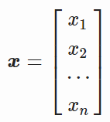
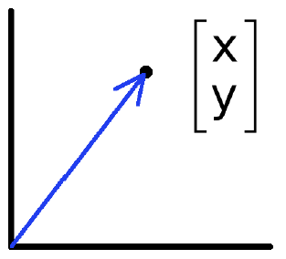
Scalar, Vectors and Matrices
•
Scalar: Is a single number that only has magnitude.
Example: Temperature
•
Vector: Is an array of numbers. It can represent an offset
space. Points are examples of vectors from origin.
in 2D or 3D

Slide 34
Scalar, Vectors and Matrices
Vectors and Matrices
•
Vectors and matrices are just collections
represent something:
of
ordered
numbers
that
-
-
-
-
-
movements in space,
scaling factors, Word counts, movie ratings,
pixel brightness's etc.

Slide 35
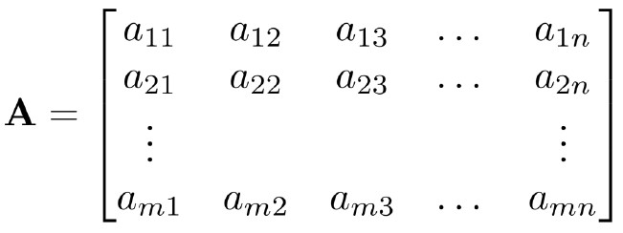
Scalar, Vectors and Matrices
•
Matrix: Is a two-dimensional array of numbers with size m (rows) by n
(columns). A matrix is called square matrix if m=n.

Slide 36
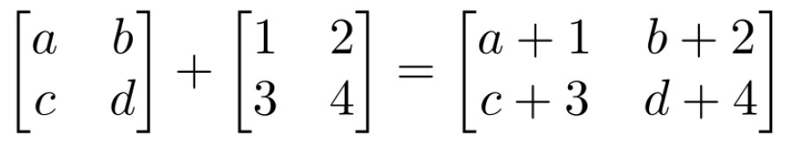
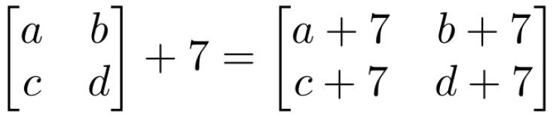
Matrix Operations
•
Matrix Addition: Works for matrix of equal dimensions and with scalar

Slide 37
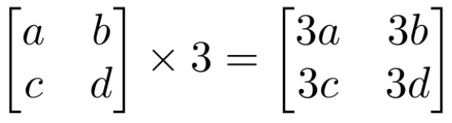
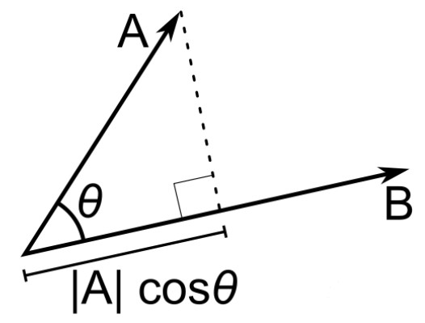
Matrix Operations
•
Scaling: Multiply each element
with the
scalar
•
Inner product (dot product) of
vectors:
If B is a unit vector, then A·B
gives the length of A which lies in the direction of B (projection)

Slide 38
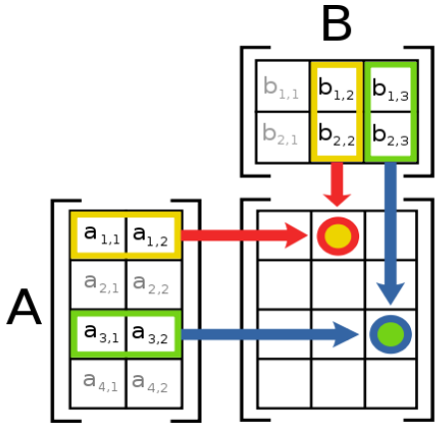
Matrix Operations
•
Multiplication: Each entry
in
the result is (that row of A) dot
product
B).
with
(that
column
of
Credit: Professor
Fei Fei Li

Slide 39
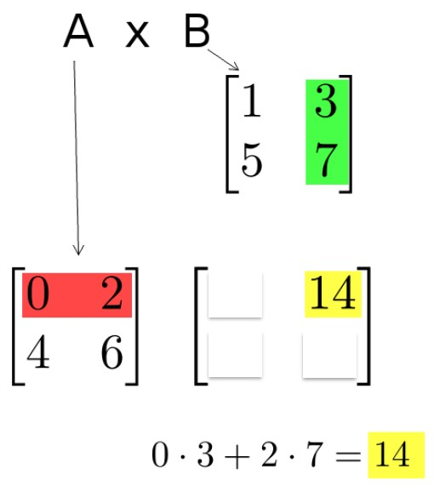
Matrix Operations
•
Multiplication example:
Each entry of the matrix product
is
made by taking the dot product of the
corresponding row in the left matrix,
with the corresponding
right one.
column
in the
Credit: Professor
Fei Fei Li

Slide 40
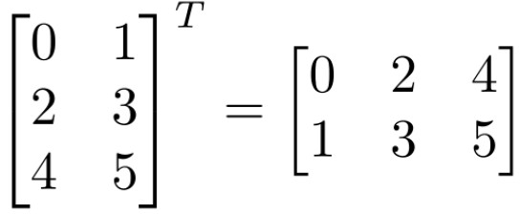
Matrix Operations
•
Transpose: Transpose flip the matrix, so row and column swap positions;
i.e., row 1 becomes column 1.
Transpose A =
A^{T}

Slide 41
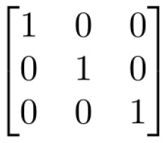
Matrix Operations
•
Identity
-
-
matrix I
Square matrix;
1’s along diagonal, 0’s elsewhere
I . [Another matrix] = [This matrix]

Slide 42
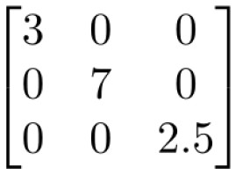
Matrix Operations
•
Diagonal matrix
-
-
Square matrix
with numbers along diagonal, 0’s elsewhere
A diagonal . [Another matrix] = Scales the rows of that matrix

Slide 43
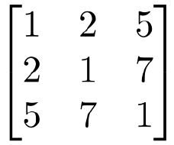
Matrix Operations
•
Symmetric matrix
-
Special matrix
with A^{T} = A

Slide 44
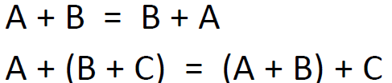
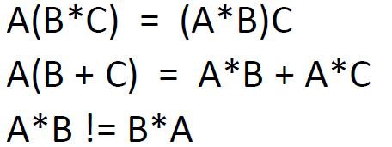
Matrix Operation Properties
•
Matrix Addition: Cumulative and associative
•
Matrix Multiplication: Associative and distributive;
not cumulative

Slide 45
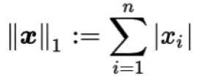
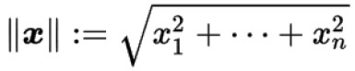
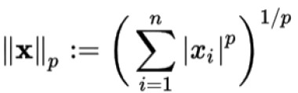
Matrix Operations [Norms]
•
L1
Norm:
Absolute-value norm
•
L2
Norm:
Euclidean norm
•
L3
Norm:
p-norm

Slide 46
Any questions so far?
Any comments?

Slide 47
Basic Statistics

Slide 48
Statistical
•
Analysis
Mean
Median
Mode
Stdv
Range
IQR
Skewness
Kurtosis
•
•
•
•
•
•
•

Slide 49
Mean, median, and mode
•
Mean, median, and mode are main measures of central tendency in a distribution.
•
Each of these measures try to summarize a dataset with a single number to represent
a typical or center data point from the numerical data set.
•
Mean good for larger sample size without outliers (symmetric
dataset)
•
Median is good for dataset with extreme values (skewed dataset)

Slide 50
Mean, median, and mode - continues
Mean: The "average" number; found by adding all data points and dividing
number of data points.
Example: The mean of 4, 1, and 7 is (4+1+7)/3 = 12/3 = 4
by the
Median: The middle number; found by ordering all data points and picking
out the
one
in the middle (or if there are two middle numbers, taking the mean of those two
numbers).
Example: The median of 4, 1, and 7 is 4 because when the numbers are put in order ( 1, 4, 7), the number 4 is in the middle.

Slide 51
Mean, median, and mode - continues
Mode: The most frequent number—that is, the number that occurs the highest number
of times.
Example: The mode of { 4, 2, 4, 3, 2, 2} is 2 because it occurs three times, which is more than any other number.

Slide 52
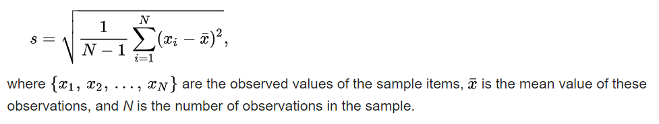
Standard Deviation
• The Standard Deviation is a measure of variation or dispersion of a
dataset.
• It is a number used to tell how measurements for a group are spread out from the average (mean), or expected value.

Slide 53
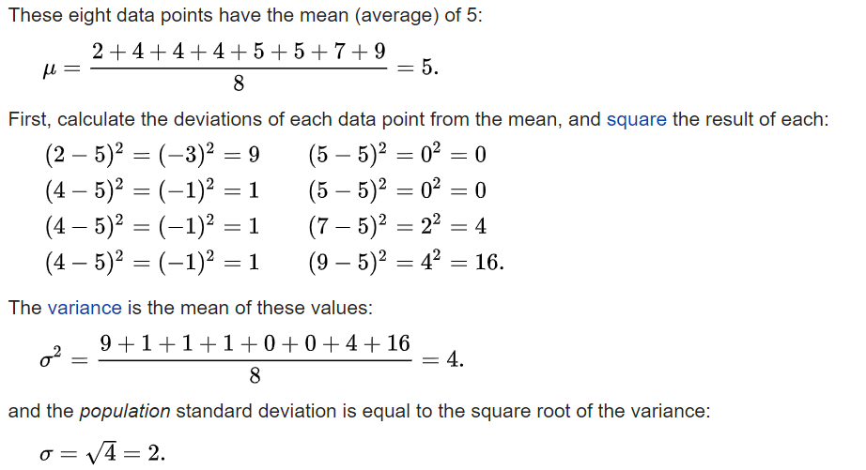
Standard Deviation - continues
The marks of a class of eight students: 2, 4, 4, 4, 5, 5, 7, 9.

Slide 54
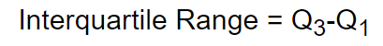
InterQuartile Range (IQR)
Interquartile Range (IQR): It is a measure of statistical dispersion, being
equal to the difference between 75th and 25th percentiles, or between
upper and lower quartiles.
- Also called the midspread or middle 50%, or technically H-spread

Slide 55
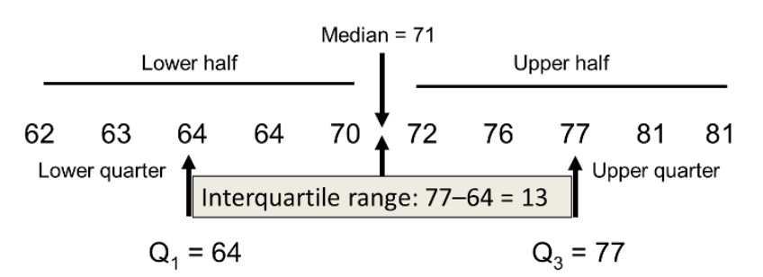
IQR- Even Sample Size

Slide 56
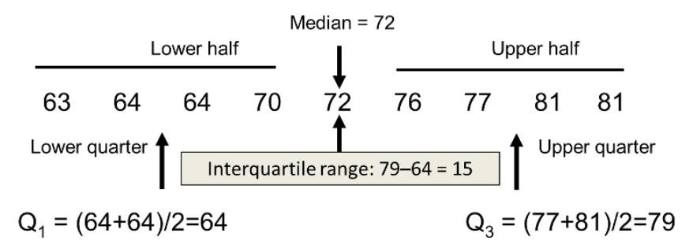
IQR- Odd Sample Size

Slide 57
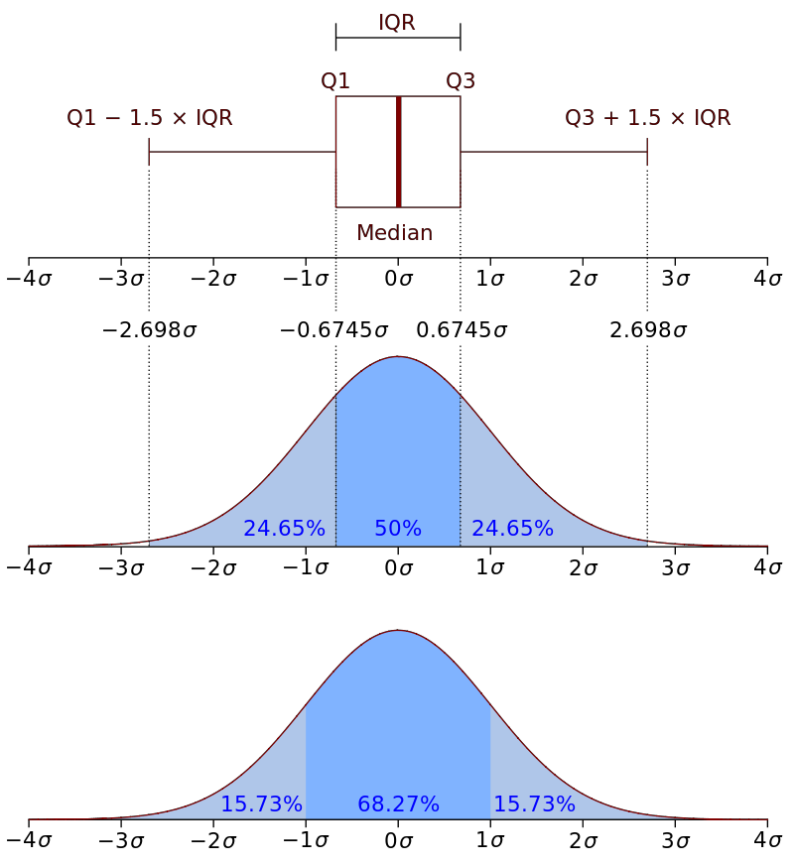
IQR - continues
• Boxplot (with an interquartile range) and a probability density
function (pdf) of a Normal N(0,σ2) Population

Slide 58
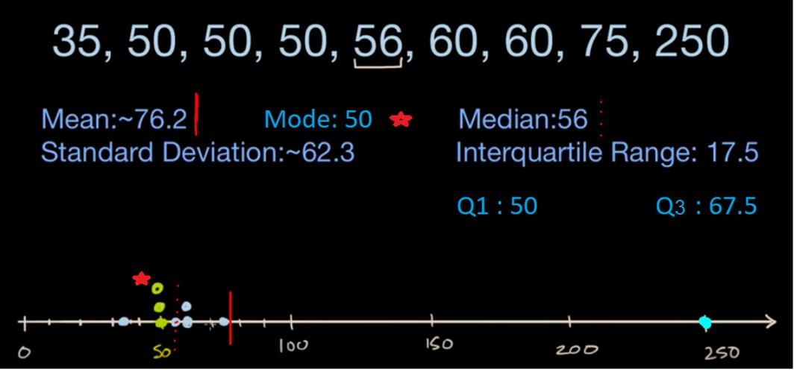
Summery - Statistical Analysis

Slide 59
Skewness
✓The skewness, that reflects the asymmetry of a
distribution
-
Skewness measures the asymmetry of a distribution. A distribution is
called asymmetric when one tail is longer than the other.
- The direction of skewness is given by the sign.
- The coefficient compares the sample distribution with a normal
distribution. The larger the value, the larger the distribution differs from
a normal distribution.
-
If the skewness is positive, then the distribution is skewed to the
right while a negative skewness implies a distribution skewed to the
left.
A zero skewness suggests a perfectly symmetric distribution.
-

Slide 60
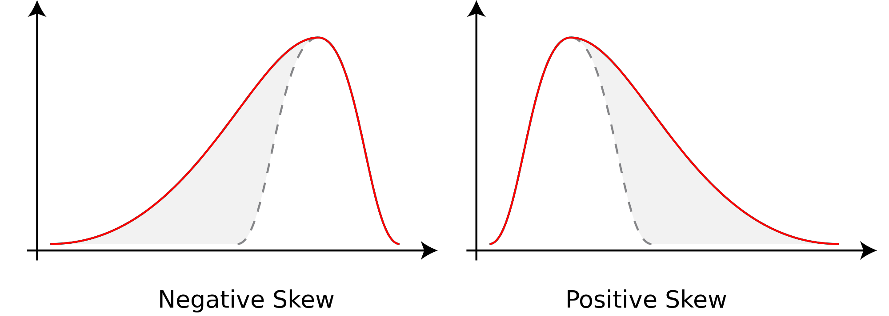
Skewness

Slide 61
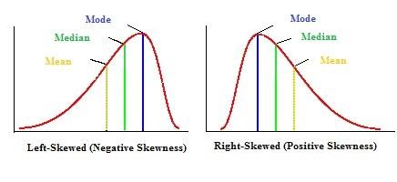
Skewness

Slide 62
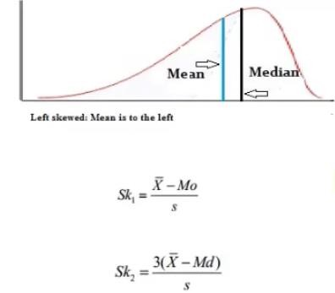
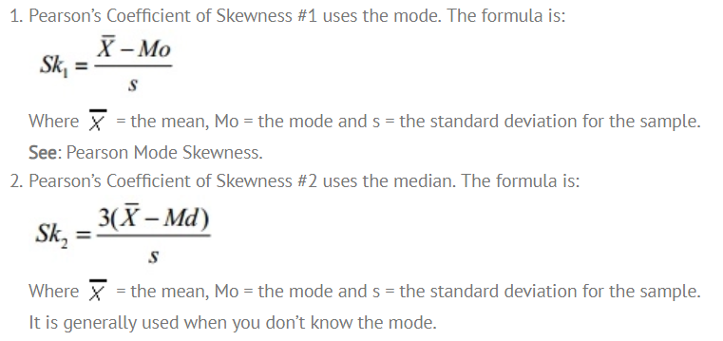
Pearson’s Coefficient of Skewness

Slide 63
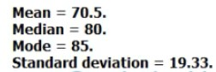
•
Pearson’s Coefficient of Skewness #1 (Mode):
Step 1: Subtract the mode from the mean: 70.5 – 85 = -14.5.
Step 2: Divide by the standard deviation: -14.5 / 19.33 = -0.75.
•
Pearson’s Coefficient of Skewness #2 (Median):
Step 1: Subtract the median from the mean: 70.5 – 80 = -9.5.
Step 2: Multiply Step 1 by 3: -9.5(3) = -28.5
Step 2: Divide by the standard deviation: -28.5 / 19.33 = -1.47.

Slide 64
Kurtosis
✓The kurtosis, that reflects the characteristics of the tails of a
distribution.
-
Kurtosis provides information on the tails (the extremes, or outliers) of a
distribution. When interpreting kurtosis, the normal distribution is used a
reference.
A positive kurtosis implies a distribution with more extreme possible data
values (outliers) than a normal distribution thus fatter tails (Leptokurtic
distributions).
A negative kurtosis implies a distribution with less extreme possible data
values than a normal distribution thus thinner tails (Platykurtic distributions).
Finally, distributions with zero kurtosis have roughly the same outlier
character as a normal distribution (Mesokurtic distributions).
-
-
-

Slide 65
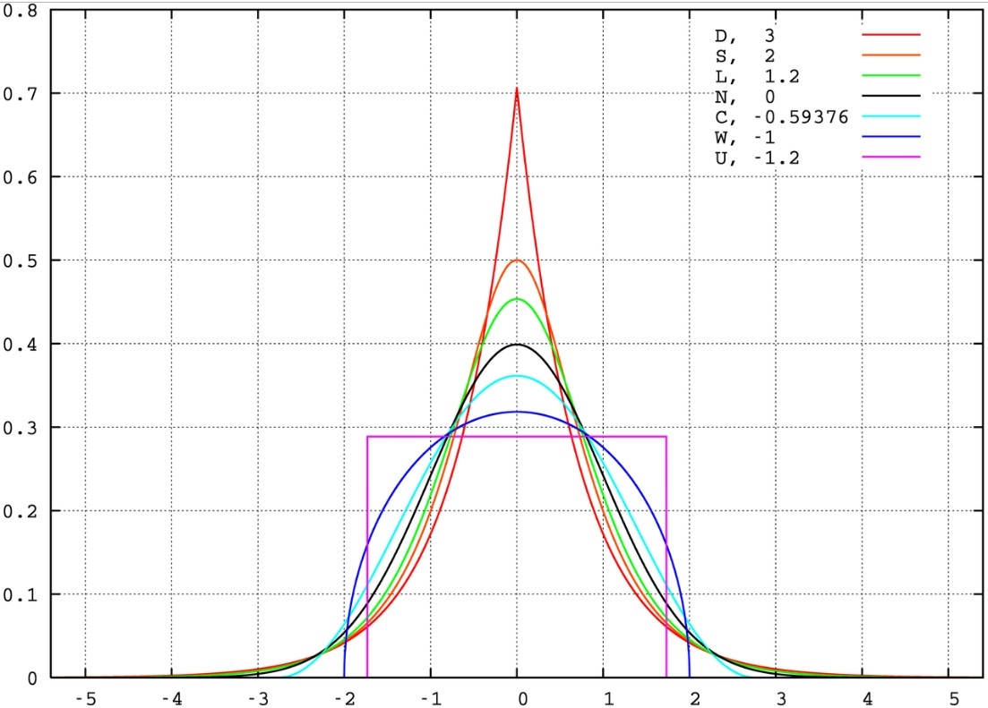
Kurtosis Example
Probability density
functions for selected
distributions with
mean 0,
variance 1 and
different excess
kurtosis

Slide 66
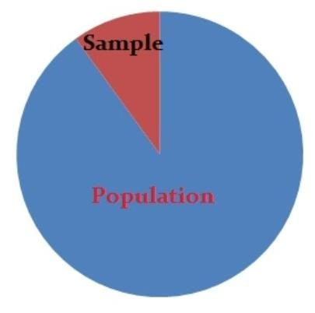
Inferential Statistics
✓Inferential statistics makes inferences and predictions about a
population based on a sample of data taken from the population
question.
in
✓This infers properties of a population
deriving estimates.
- Descriptive statistics describes data
(for example, a chart or graph)
by
testing
hypotheses
and
- Inferential statistics allows you to make
predictions (“inferences”) from that data.

Slide 67
Inferential Statistics – Main Areas
✓Estimating parameters: This means taking a statistic from your sample data (for
example the sample mean) and using it to say something about a population
parameter (i.e. the population mean).
✓Hypothesis tests: This is where you can use sample data to answer research questions.
For
-
-
example,
Interested in knowing if a new cancer drug is effective. Or
If breakfast helps children perform better in schools.

Slide 68
Inferential Statistics – continues
✓Regression and Correlation analysis are statistical
techniques used extensively to examine causal
relationships between variables.
- Measure the degree of relationship between two or more
variables in two different but related ways.
✓Regression Analysis: a single dependent variable,
is considered to be a function of one or more
independent variables, X1, X2, and so on. The
values of both the dependent and independent
variables are assumed as being ascertained in an
error-free random manner.
Y,

Slide 69
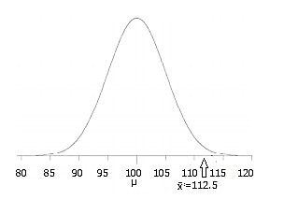
Inferential Statistics – continues
•
Inferential statistics you take that sample data
from a small number of people and try to
determine if the data can predict whether the
will work for everyone (i.e. the population).
- Calculating a z-score is a way to do this
drug
d deviations
Z-score is the number of standar
from the mean a data point is.
- It’s way to show where your data
would
lie in a normal distribution to post-hoc

Slide 70
Probability
✓Probability is a measure quantifying the likelihood that events will occur (simply how
likely something is to happen).
- The higher the probability of an event, the more likely it is that the event will
occur.
- Probability quantifies as a number between 0 and 1; 0 indicates impossibility and 1
indicates certainty.
Example: Probability of flipping a unbiased coin:
- There are two possible outcomes—head or tail; each with a probability of 0.5

Slide 71
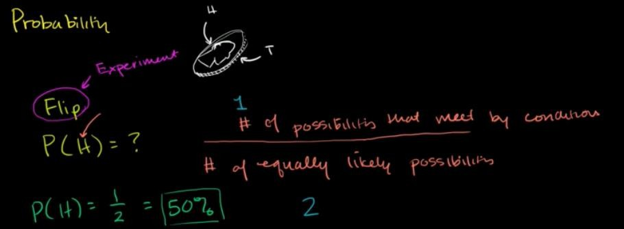
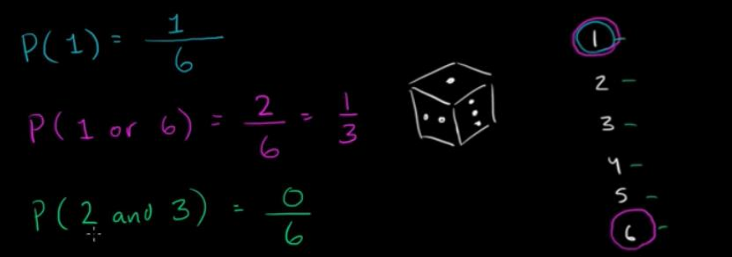
Probability - Example

Slide 72

Probability - Terms
✓Random variable (random quantity, aleatory variable, or stochastic
variable) is described informally as a variable whose values
outcomes of a random phenomenon.
depend
on
- Examples of random phenomena
can include the results of an
experiment or survey.
- Flipping a unbiased coin
experiment.

Slide 73


Probability Distribution
✓Probability distribution is a table or an equation that links each outcome of a
statistical experiment with its probability of occurrence.
Example: An desired outcome of the experiment might be the number of heads that we see in two coin flips:

Slide 74



Probability Distribution – Two dice flips

Slide 75
Probability Distribution - continues
✓Probability distribution are generally divided into two classes:
- Continuous probability distribution
- Discrete probability distribution

Slide 76
Continuous probability distribution
•
Continuous distribution describes the probabilities of the possible
values of a continuous random variable.
Continuous random variable is a random variable with a set of possible values (known as the range) that is infinite and uncountable.
Probabilities of continuous random variables (X) are defined as the
area under the curve of its PDF.
•
•
-
-
Thus, only ranges of values can have a nonzero probability.
The probability that a continuous random variable equals some value
is always zero.

Slide 77

Continuous probability distribution
• Distribution plot of the weight of adult males

Slide 78
Discrete probability distribution
•
Discrete distribution describes the probability of occurrence of each
value of a discrete random variable.
A discrete random variable is a random variable that has countable values, such as a list of non-negative integers.
With a discrete probability distribution, each possible value of the discrete random variable can be associated with a non-zero probability.
Discrete probability distribution is often presented in tabular form.
•
•
•

Slide 79

Mean (expected value)
Mean (expected value) of a discrete random variable

Slide 80

Mean (expected value) - continues
Mean (expected value) of a discrete random can be non-integer.

Slide 81

Variance and Standard deviation
Variance and standard deviation of a discrete random variable

Slide 82
Concept of
correlation
Correlation
•
Correlation describe the linear relationship between two continuous
variables. It indicates the trend of change in one variable
in values of other variable.
with the
change
•
Importance:
-
-
-
Correlation can help in predicting one quantity from
It can indicate the presence of a causal relationship
another
Correlation is used as a foundation for many other modeling
techniques

Slide 83
Concept of
correlation
Correlation types
•
Positive Correlation: as one variable
increases so does the other.
-
Height and shoe size are an example; as one's height increases so
does the shoe size.
•
Negative Correlation: as one variable increases, the other decreases.
-
Inflation rate and purchase power are negatively correlated;
Higher rate of inflation means expensive commodities, thus lower
purchase power.

Slide 84

Concept of correlation
Correlation types
•
No Correlation: there is no apparent
relationship between the variables.
-
Inflation and shoe size apparently have no relationship between them.

Slide 85

Random Sampling
Random sampling is a way of selecting a sample of observations
from
a
population in order to make inferences
about
the
population.
•
Each individual in the sample has
been chosen entirely at random (by chance), and
All have the same probability to be
chosen.
Example: Polls from voters to
predict election outcome.
•
•
credit: displayr.com

Slide 86
Random Sampling
Random sampling types
•
Simple random sampling: It
is subset of individual randomly chosen
from a larger set called population.
•
Stratified random sampling: Performed by breaking a population into
key
-
subgroups and obtaining a simple random sample from each group.
To ensure participation from male-female and both adult and child;
the four sub-group can be adult-female, girls, boys, adult-males.
Then Simple random sampling can be used to take equal number of
individuals from each group
-

Slide 87
Concept of
correlation
Correlation types
•
Positive Correlation: as one variable
increases so does the other.
-
Height and shoe size are an example; as one's height increases so
does the shoe size.
•
Negative Correlation: as one variable increases, the other decreases.
-
Inflation rate and purchase power are negatively correlated;
Higher rate of inflation means expensive commodities, thus lower
purchase power.

Slide 88
Installing Python and Pycharm
• https://www.python.org/downloads/
• https://www.jetbrains.com/pycharm/download/#section=windows
(download the free version)

Slide 89
Installing Python and Pycharm
•
Install with pip https://packaging.python.org/installing/
–python -m pip install -U pip setuptools(installing pip)
–pip install -U pip (updating pip)
–Pip install “library_name”
•
Install with easy_install
–easy_install“library_name”
•
Install with wheel (.whlfiles)
-
-
-
Go to binaries for python packages
Pip install wheel
pip install PATH+“library_name”.whl
http://www.lfd.uci.edu/~gohlke/pythonlibs/

Slide 90
Further Readings
• Data-Mining Boosts Netflix's Subscriber Base

